Slide 1
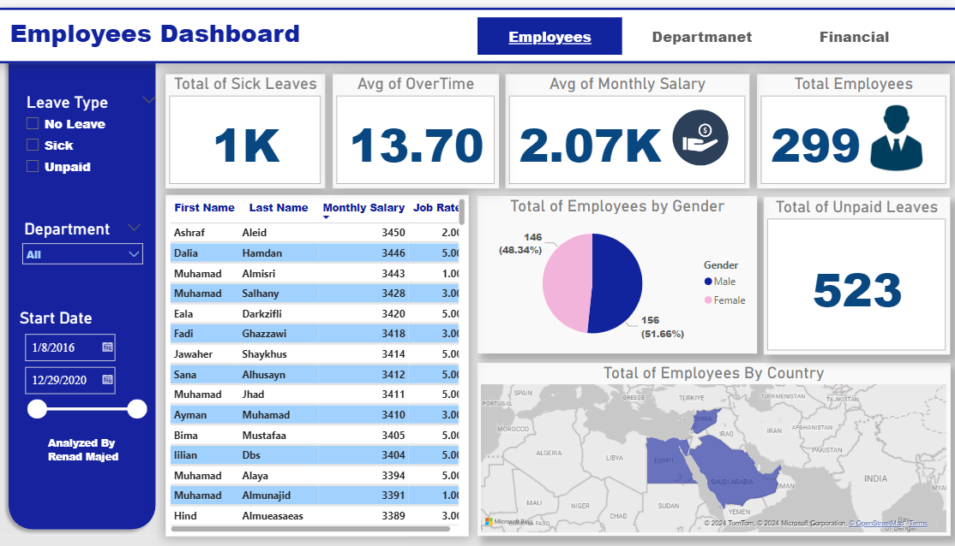

Analysis of Workforce Metrics and Financial Performance
By: Renad Majed

Slide 2


Overview
Employee Dashboard Insights
01
Department Dashboard Insights
02
Financial Dashboard Insights
03

Slide 4
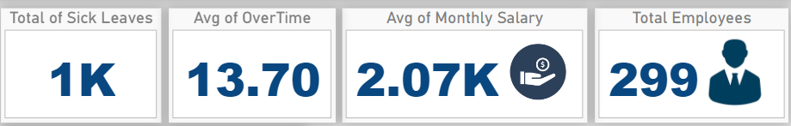
Employees Dashboard
Overview of Total Employees
insight: "Total employees: 299"
Suggestion: Highlight the importance of workforce size in relation to company goals.
Sick Leaves Overview
Insight: "Total sick leaves: 1,000"
Suggestion: Discuss the potential impact of high sick leave on productivity.
Salary Insights
Insight: "Average monthly salary: $2,070"
Suggestion: Compare this with industry averages to assess competitiveness.
Overtime Insights
Insight: "Average overtime: 13.70 hours"
Suggestion: Address how overtime may indicate workload issues.

Slide 5
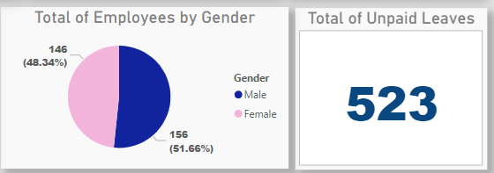
Employees Dashboard
Gender Breakdown
Insight: "Total employees by gender: Male 51.66%, Female 48.38%"
Suggestion: Discuss diversity and gender representation in the workforce.
Unpaid Leaves
Insight: "Total unpaid leaves: 532"
Suggestion: Analyze reasons for unpaid leaves and their impact.

Slide 6

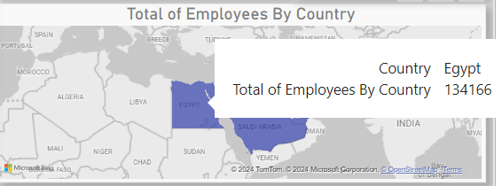
Employees Dashboard
Employee Distribution by Country
Insight: "Egypt has the most employees."
Suggestion: Discuss regional workforce strategies.

Slide 7
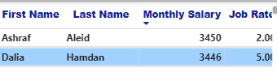
Employees Dashboard
Top Salary
Insight: "Ashraf Aleid has the highest salary at $3,450"
Suggestion: Explore the significance of top salaries in retention.

Slide 8
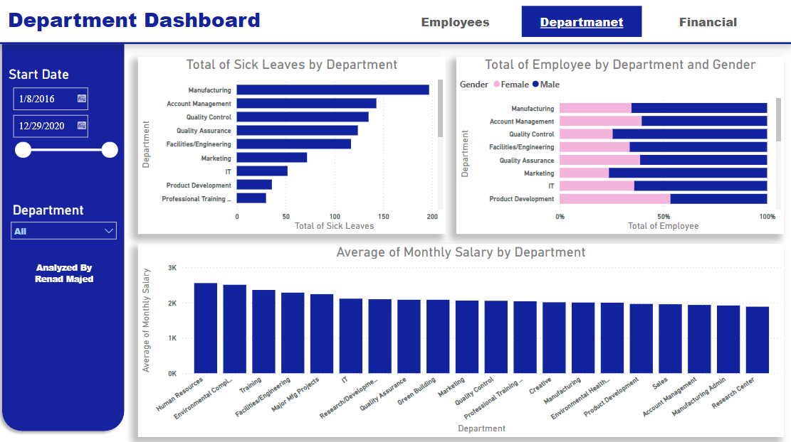

Slide 9
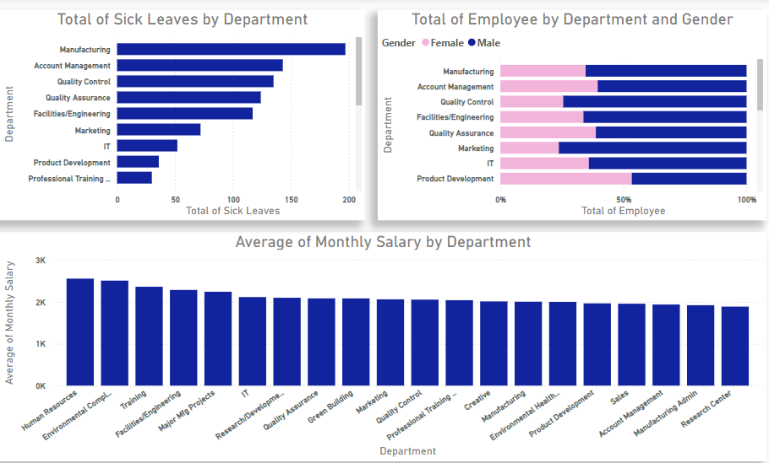
Department Dashboard
Sick Leaves by Department
Insight: "Manufacturing has the most sick leaves."
Suggestion: Investigate the causes of high sick leaves in manufacturing.
Employee Gender by Department
Insight: "Manufacturing has 65.34% male employees."
Suggestion: Discuss gender balance in critical departments.

Slide 10
Department Dashboard
Average Salary by Department
Insight: "Human Resources has the highest average salary."
Suggestion: Discuss the reasons behind salary differences across departments.

Slide 11
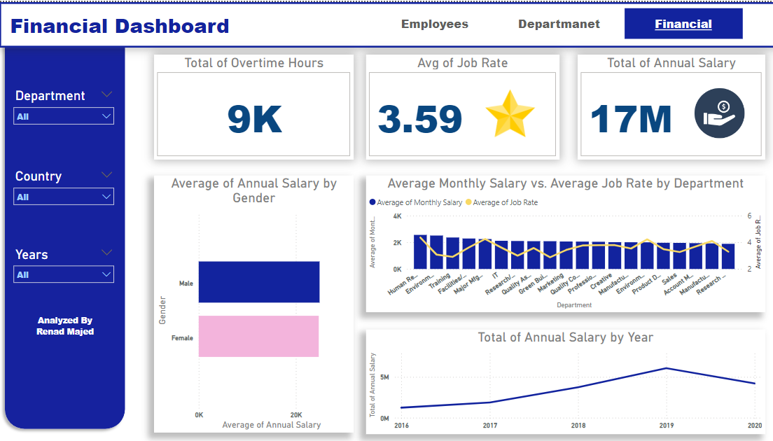

Slide 12
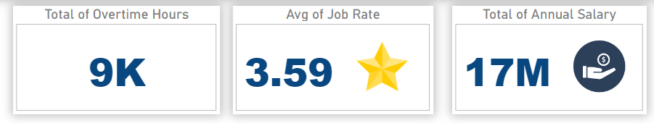
Financial Dashboard
Statistics
Overtime Hours
Insight: "Total overtime hours: 9,000"
Suggestion: Reflect on the implications of high overtime on finances.
Job Rate
Insight: "Average job rate: $3.59"
Suggestion: Compare job rates against industry benchmarks.
Annual Salary Insights
Insight: "Total annual salary: $17 million"
Suggestion: Address the financial impact on the organization.

Slide 13
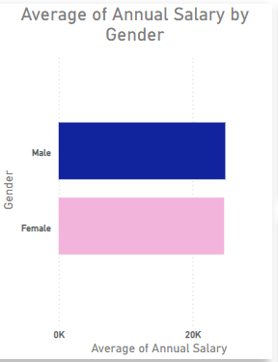
Financial Dashboard
Annual Salary by Gender
Insight: "Average annual salary by gender: Males earn more."
Suggestion: Discuss pay equity and strategies for improvement.

Slide 14
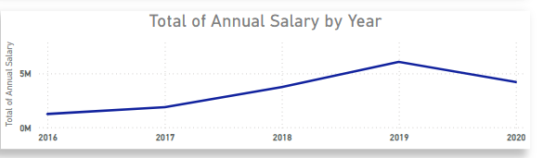
Financial Dashboard
Annual Salary by Year
Insight: "2019 had the highest total annual salary."
Suggestion: Analyze trends over the years and their implications.

Slide 15
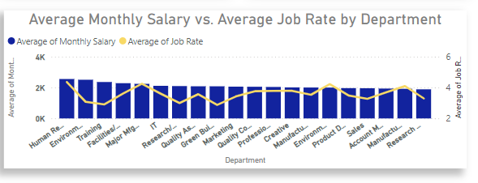
Financial Dashboard
Average Salary vs. Job Rate by Department
Insight: "Human Resources has the highest average monthly salary ($2,070) and job rate (4.36)."
Suggestion: Discuss the relationship between job rates and salaries.

Slide 16

THANK YOU!

